Slide 1

Chapter 4: Navigating Uncertainty in Artificial Intelligence
Uncertainty is a fundamental aspect of real-world AI applications, influencing how we build reliable and effective systems. This presentation dives into the concept of uncertainty in AI, exploring its sources, how AI systems address it, and the important trade-offs involved.

Slide 2
What is Uncertainty in AI?
Definition
Sources of Uncertainty
Uncertainty in AI refers to a lack of complete knowledge about the state of the environment or the outcomes of actions. It arises from various sources, making it a crucial factor to consider when developing AI systems.
Incomplete data
Imperfect models
Stochastic environments
Sensor Limitations

Slide 3
Real-World Example: Weather Prediction
The Challenge of Forecasting
Probabilistic Forecasts
Weather prediction is a classic example of an AI application dealing with uncertainty. Forecasting relies on data like temperature, pressure, humidity, and wind speed, all of which contain inherent measurement errors.
Weather models are complex numerical simulations with inherent approximations. As a result, outputs are probabilistic forecasts, expressing the likelihood of different weather events. For instance, a forecast might state a "70% chance of rain," reflecting the model's uncertainty about the actual outcome.

Slide 4
Probabilistic Models: Bayesian Networks
1
1. Representation of Probabilistic Relationships
2
2. Nodes and Edges
3
3. Conditional Probabilities
Nodes in a Bayesian Network represent variables, such as "Cloudy," "Rain," or "Sprinkler," while edges signify probabilistic dependencies between these variables. For instance, an edge from "Cloudy" to "Rain" indicates that the presence of clouds influences the probability of rain.
Conditional probabilities are used to quantify the strength of these relationships. For example, P(Rain | Cloudy) would represent the probability of rain given that it is cloudy. These probabilities are learned from data or expert knowledge and help inform decisions made based on the network.
Bayesian Networks provide a visual and mathematical framework for representing and reasoning about uncertain relationships among variables. They are particularly useful when dealing with complex systems where dependencies between events play a crucial role.

Slide 5

Probabilistic Models: Markov Decision Processes (MDPs)
Mathematical Framework for Decision Making
Markov Decision Processes (MDPs) are a mathematical framework that models decision-making under uncertainty. They are particularly useful when an agent needs to make sequential decisions in an environment with unpredictable outcomes.
Components of an MDP
States: Possible situations the agent can be in
Actions: Choices the agent can make
Rewards: Numerical values representing the desirability of outcomes
Transition Probabilities: Probability of moving from one state to another given an action

Slide 6



How AI Systems Handle Uncertainty
Probabilistic Reasoning
Machine Learning
Reinforcement Learning
AI systems often employ probabilistic reasoning to make inferences and predictions in the presence of uncertainty. This involves using probabilities to quantify beliefs about the likelihood of events and updating those beliefs as new data becomes available.
Machine learning techniques are frequently used to train models on uncertain data. This allows AI systems to learn patterns and make predictions even when faced with imperfect or incomplete information.
Reinforcement learning is a powerful approach for learning optimal policies in uncertain environments. It involves an agent interacting with its surroundings, receiving feedback in the form of rewards, and gradually improving its behavior through trial and error.

Slide 7
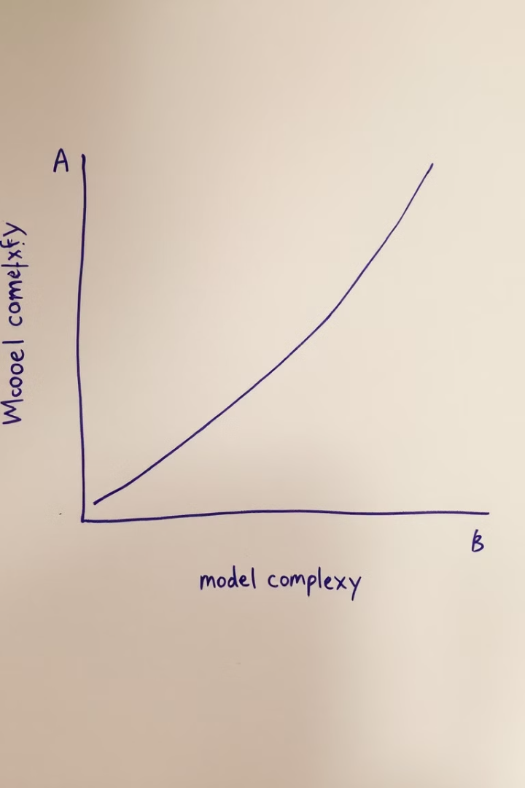
Trade-offs in Handling Uncertainty
1
Accuracy vs. Computational Cost
A common trade-off is between accuracy and computational cost. More complex models can potentially achieve higher accuracy but often require more computational resources, making them less practical for real-time applications.
2
Robustness vs. Sensitivity
Another trade-off involves robustness versus sensitivity. Models that are robust to uncertainty may be less sensitive to subtle changes in data or environmental conditions, while more sensitive models might perform better under ideal circumstances but struggle with noisy or unpredictable inputs.
3
Exploration vs. Exploitation
This trade-off is particularly relevant to reinforcement learning. AI agents need to balance exploring new possibilities to discover potentially better solutions with exploiting known information to maximize immediate rewards.

Slide 8

Conclusion: Embracing Uncertainty in AI
Uncertainty is an integral part of real-world AI applications. By understanding its sources and developing effective methods for handling it, we can build more robust and reliable AI systems. Probabilistic models provide powerful tools for representing and reasoning about uncertainty, while recognizing the trade-offs involved is crucial for designing systems that strike the right balance between performance and practicality. As AI research continues to advance, ongoing advancements in uncertainty-aware AI will be essential for unlocking the full potential of this transformative technology.

